Slide 1



Image Caption generator
Team members: Mayurkumar M Patel(online)
tirth g shah

Slide 2
Introduction
Image captioning is based on image processing/computer vision followed by machine translation which is used to generate sentences based on the image provided.
For this, we will use ResNet, Word2Vec, and LSTM.
In this project, we tried to create a model with high accuracy and try to get meaningful text description based on the images and categorize the images and additionally provide suggestions for social media captions.

Slide 3
Motivation
The real reason behind doing such project is to try and create an efficient model for image captioning so that it can be implemented at a wider scale for the visually impaired.
If we achieve a 95% or higher accuracy, it may be useful for doctors to use this for reading scanned X-rays for detecting injuries or diseases related to lungs.
This is not only for the visually impaired, but it has many other useful applications. And hence we chose this topic.

Slide 4
Approach
Try and test pre-trained models like InceptionV3 and VGG16 but accuracy was not desirable.
Based on the flaws, we created a combination of ResNet101 and LSTM model for better accuracy.
Use dataset to train and test the model.
Use evaluation metrics to evaluate and achieve highest accuracy.

Slide 5
Method
Collect Dataset, Pre-process the dataset.
ResNet101 will be used for the model training.
Train the Model based on the dataset.
Create a GUI/Front-end for testing the model.

Slide 6
Software Tools to be used:
Python 3.8
Libraries:
Numpy
Tensorflow
Keras
NLTK
PIL
Matplotlib
TQDM

Slide 7
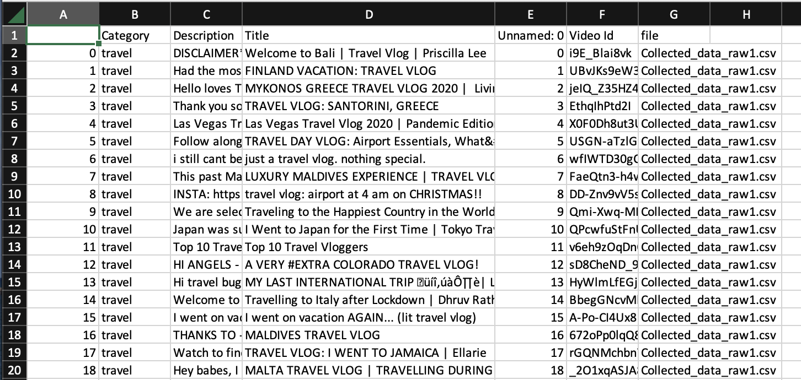
Dataset
In this project, we will be using the Flickr8k Dataset.
This is a dataset of images created by University of Illinois at Urbana-Champaign.
The dataset consists of 8000 images paired with 5 different captions which provide proper description of the image.
For text categorization, we used Youtube API data for text categorization consists of 20K Titles

Slide 8
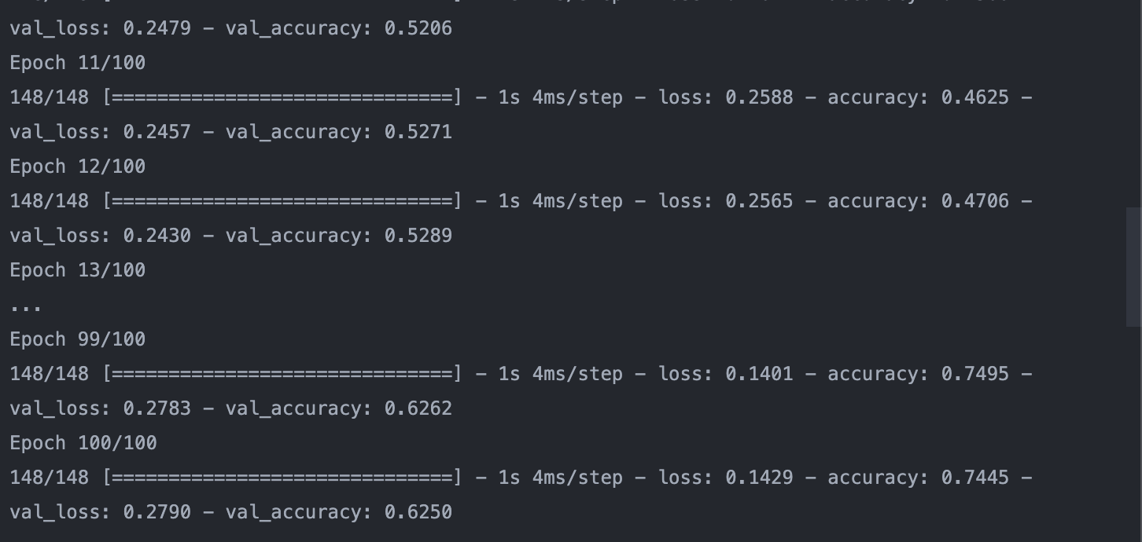
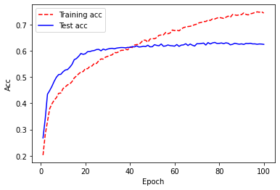
Text Categorization
Dataset used: YouTube API Data for text categorization.
Tokenization and Vectorization.
Generating word embeddings using Word2Vec and KeyedVectors.
Split Data for training and testing, and by using Dense Neural Network, we trained the model and tested the model for predicting the categories.

Slide 9
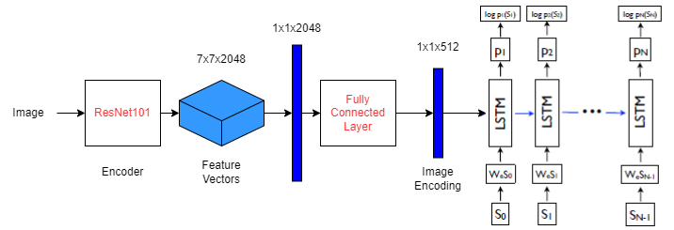
Image Processing
We used Flicker 8K dataset, and split it for training, testing and validation.
Here, ResNet101 was used as it was the most efficient and provided better accuracy than the other models.
And we added a LSTM layer for generating image description over the results generated via image encoding.

Slide 10
Inception V3 vs VGG16 vs ResNet101
Amongst Inception V3 and VGG 16, VGG 16 was better as the overfitting was less and accuracy provided was better.
But it requires a lot of computational power as compared to ResNet101 which is deeper, i.e., it has more layers yet it is smaller, faster and provides better accuracy than VGG 16 in this case.

Slide 11
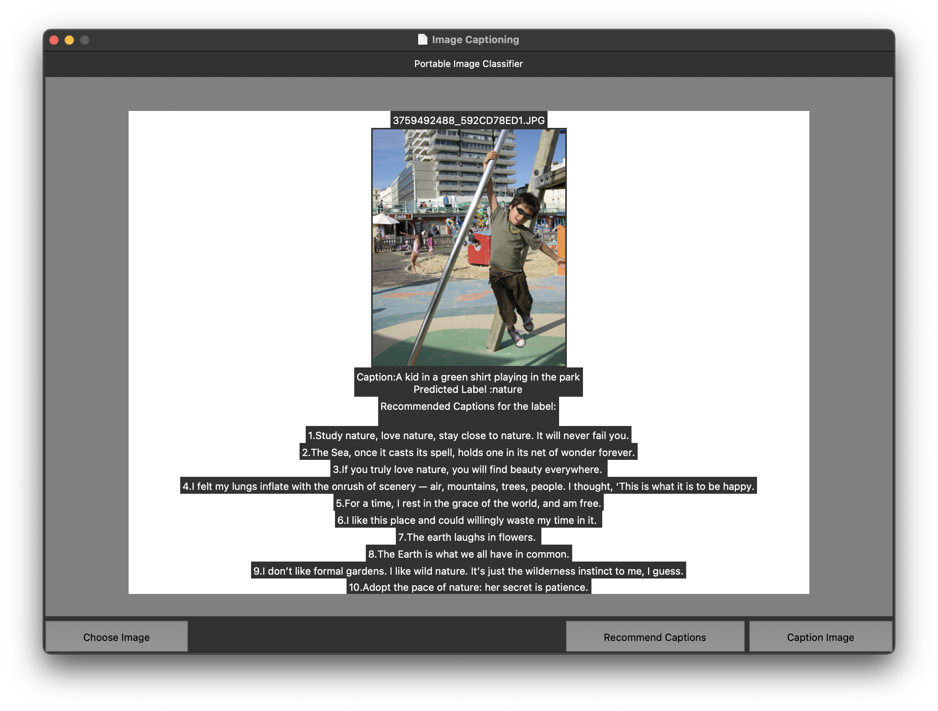
Front-end for Testing

Slide 12
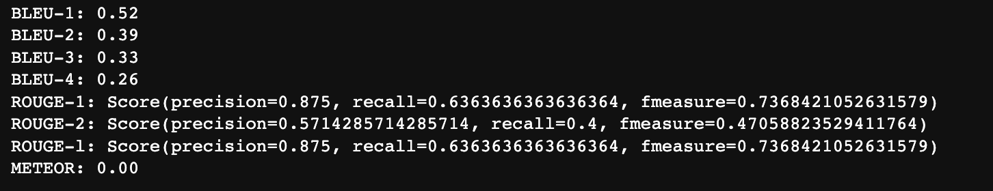
Evaluation
We used BLEU(BiLingual Evaluation Understudy Scores and Rouge(Recall-Oriented Understudty) Scores for evaluation.

Slide 13
Citation
Show and Tell: A Neural Image Caption Generator - Oriol Vinyals, Alexander Toshev, Samy Bengio, Dumitru Erhan
Image Caption Generator - Megha J Panicker, Vikas Upadhayay, Gunjan Sethi, Vrinda Mathur
An Overview of Image Caption Generation Methods - HaoranWang , Yue Zhang, and Xiaosheng Yu

Slide 14
Thank you!

